Slide 1

Lecture 05 Two Dimensional Graphics Part 3
Working with Images
Reference: Java-Tutorials/tutorial-2015/2d/images/index.html

Slide 2
Contents
Introduction
The java.awt.Image Class
The java.awt.image.BufferedImage Class
The java.awt
Reading/Loading an Image
Drawing an Image
Demonstrations
Teach yourself
Creating and drawing to an image
Writing/Saving an image

Slide 3
1- Introduction
There are a number of common tasks when working with images.
Loading an external GIF, PNG JPEG image format file into the internal image representation used by Java 2D.
Directly creating a Java 2D image and rendering to it.
Drawing the contents of a Java 2D image on to a drawing surface.
Saving the contents of a Java 2D image to an external GIF, PNG, or JPEG image file.

Slide 4
Introduction…
The are two main classes that you must learn about to work with images:
The java.awt.Image class is the superclass that represents graphical images as rectangular arrays of pixels.
The java.awt.image.BufferedImage class, which extends the Image class to allow the application to operate directly with image data (for example, retrieving or setting up the pixel color). Applications can directly construct instances of this class.
The BufferedImage class is a cornerstone of the Java 2D immediate-mode imaging API. It manages the image in memory and provides methods for storing, interpreting, and obtaining pixel data. Since BufferedImage is a subclass of Image it can be rendered by the Graphics and Graphics2D methods that accept an Image parameter.
A BufferedImage is essentially an Image with an accessible data buffer. It is therefore more efficient to work directly with BufferedImage. A BufferedImage has a ColorModel and a Raster of image data. The ColorModel provides a color interpretation of the image's pixel data.

Slide 5
Introduction…
The Raster performs the following functions:
Represents the rectangular coordinates of the image
Maintains image data in memory
Provides a mechanism for creating multiple subimages from a single image data buffer
Provides methods for accessing specific pixels within the image

Slide 6
2- The java.awt.Image Class
public abstract class Image extends Object
The abstract class Image is the superclass of all classes that represent graphical images. The image must be obtained in a platform-specific manner.
https://docs.oracle.com/javase/8/docs/api/java/awt/Image.html
Constructor: Image(void)
Common Methods

Slide 7
3- The java.awt.image.BufferedImage
public class BufferedImage extends Image implements WritableRenderedImage, Transparency
The BufferedImage subclass describes an Image with an accessible buffer of image data. A BufferedImage is comprised of a ColorModel and a Raster of image data. The number and types of bands in the SampleModel of the Raster must match the number and types required by the ColorModel to represent its color and alpha components. All BufferedImage objects have an upper left corner coordinate of (0, 0). Any Raster used to construct a BufferedImage must therefore have minX=0 and minY=0.This class relies on the data fetching and setting methods of Raster, and on the color characterization methods of ColorModel.

Slide 8
4- Reading/Loading an Image
Loading a local image:
BufferedImage img = null;
try {
img = ImageIO.read(new File("strawberry.jpg"));
} catch (IOException e) { }
Loading a remote image:
try {
URL url = new URL(getCodeBase(),"examples/strawberry.jpg");
img = ImageIO.read(url);
} catch (IOException e) { }
Package javax.swing.imageio.ImageIO contains methods for reading/writing image files
The method getCodeBase() will create a connection to server to get the resource
You can use the class java.awt.Toolkit to read an image file as following”
Image Img = Toolkit.getDefaultToolkit().getImage(FileName);

Slide 9
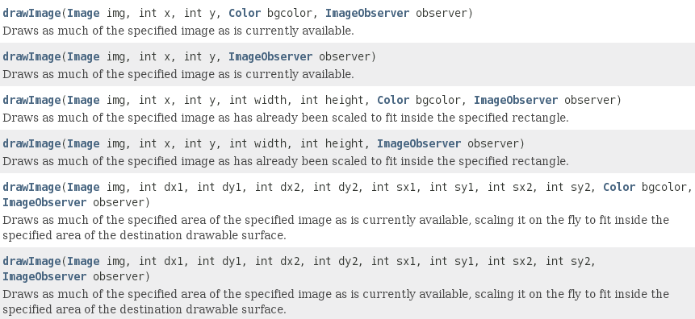
5- Drawing an Image
Use the method drawImage(…) of the Graphics class
boolean Graphics.drawImage(image, x, y,…);
x, y: left corner of the drawing area
The observer parameter notifies the application of updates to an image that is loaded asynchronously. The observer parameter is not frequently used directly and is not needed for the BufferedImage class, so it usually is null.

Slide 10
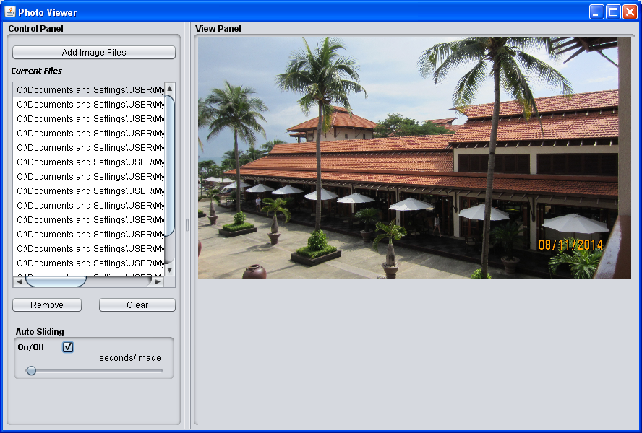
Demonstration
This demonstration will help you how to develop a program for viewing image list stored in your computer.

Slide 11
Demonstration…
Click for adding images to the list
Click for viewing an image
Remove some images from the list
Change slide rate
Click for auto sliding

Slide 12
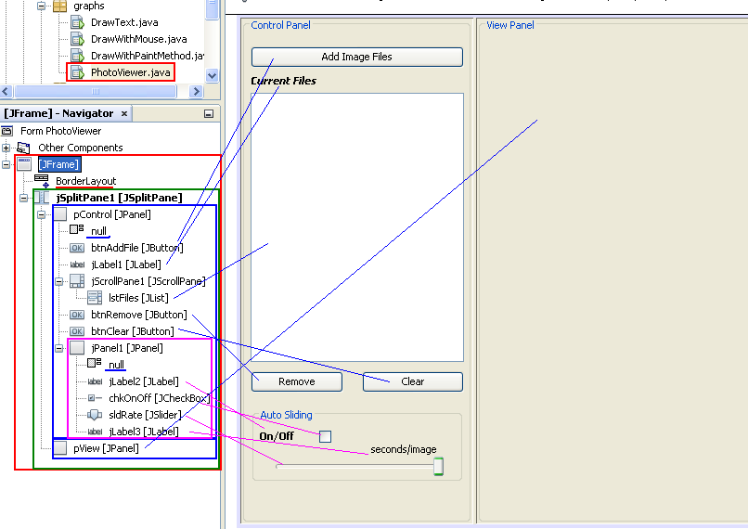
Design
JSplitPane1 Properties
Orientation: HORIZONTAL_SPLIT
DividerLocation: 250
lstFiles Properties
SelectionMode: SINGLE
Model: Blank
pView Properties
PreferredSize: (1000,800)

Slide 13
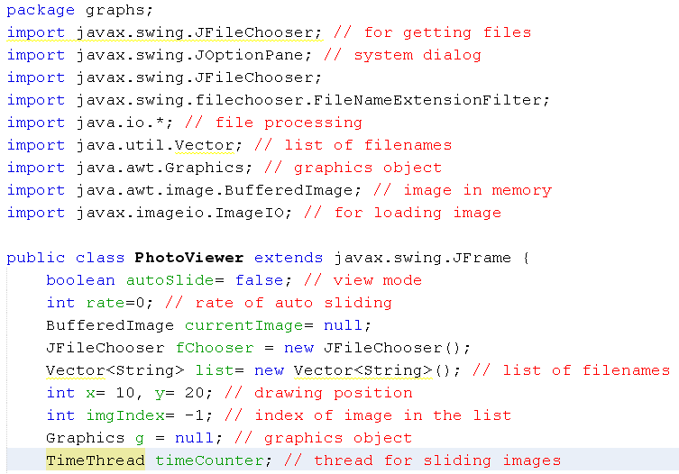
Code
The program supports auto-sliding through a thread. So, an inner class is declared.

Slide 14
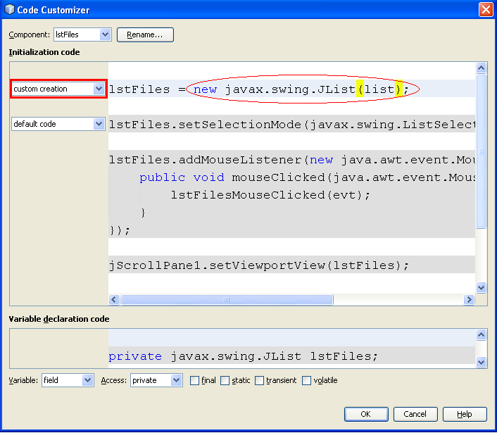
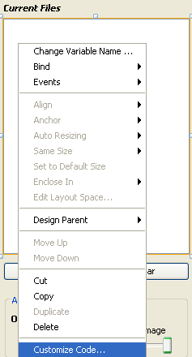
Code
Step 2
Step 3
Step 1:
Right click to the listbox
We want the list of filenames (the variable list) will be the model of the listbox lstList. Return to the design window to complete this work.
Step 4

Slide 15
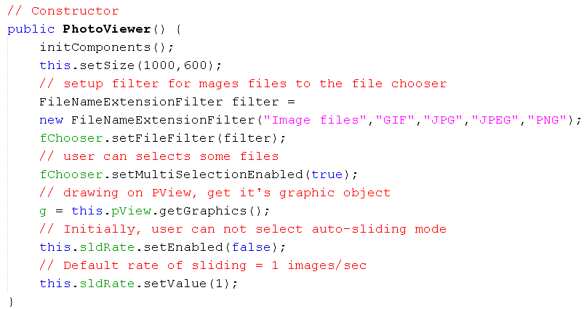
Code

Slide 16
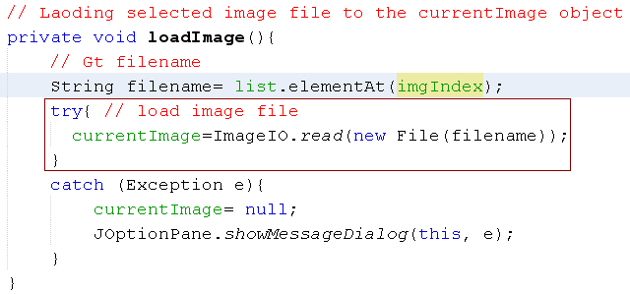
Code

Slide 17
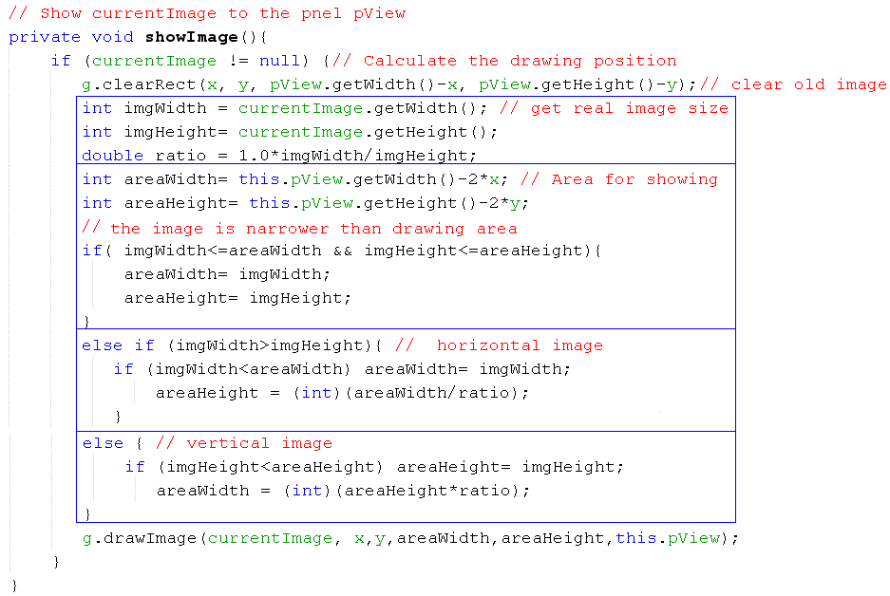
Code

Slide 18
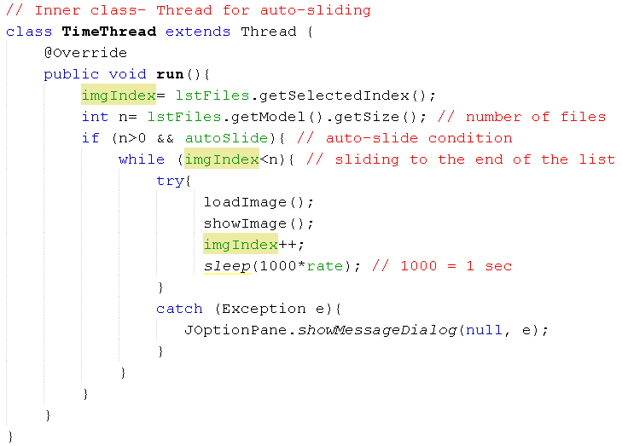
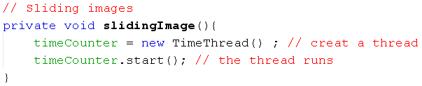
Code

Slide 19
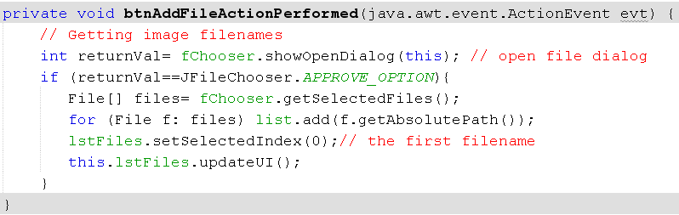
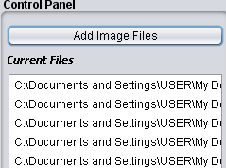
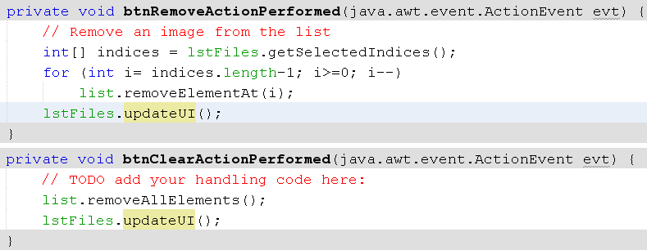
Code

Slide 20
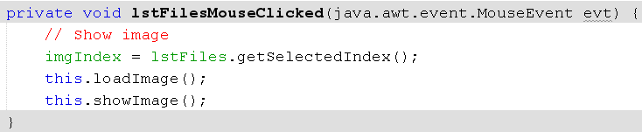
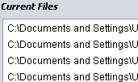
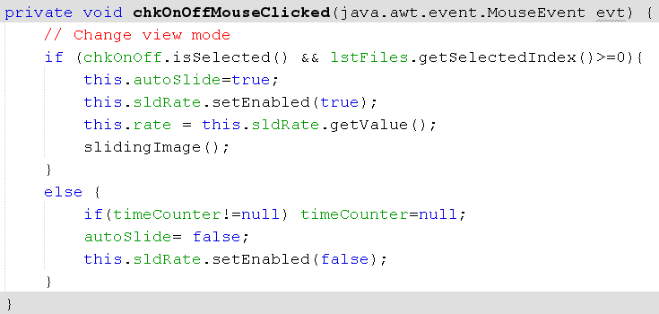


Code

Slide 21
Summary
Introduction
The java.awt.Image Class
The java.awt.image.BufferedImage Class
The java.awt
Reading/Loading an Image
Drawing an Image
Demonstrations

Slide 22
Summary
Introduction
Reading/Loading an Image
Drawing an Image
Creating and Drawing to an Image
Demonstration

Slide 23
Thank You

